Slide 1

MAHARASHTARA STATE BOARD OF TECHNICAL EDUCATION
GOVERNMENT POLYTECHNIC , JINTUR
Department Of Computer Engineering
Project Title :
“SMART ATTENDANCE SYSTEM WITH FACE RECOGNITION”
GUIDED BY : M. A. Zahed

Slide 2
SMART ATTENDANCE SYSTEM WITH FACE RECOGNITION
Final year Project By:
Name of Students Enrollment No.
1. Aditya Ganesh Shinde 23510240164
2. Nagesh Balaji Sorgekar 23510210167
3. Jivan Balaji Sudke 23510210168
4. Bhagwan Gautam Waghmare 24510240182
GUIDED BY: M. A. Zahed

Slide 3
Introduction:
Automated Solution : A smart attendance system developed using AI and Machine Learning to replace traditional manual registers.
Face Recognition Technology: Uses Google ML Kit and TensorFlow Lite to identify students by extracting unique 128-dimensional facial features.
Real-time Synchronization: Powered by Firebase Cloud Firestore, ensuring attendance logs are updated and accessible instantly to both teachers and students.
Edge Computing Efficiency: All facial processing happens locally on the mobile device, resulting in high-speed recognition (under 2 seconds).

Slide 4
Technology / Tools Stack
Component | Technology / Tool | Purpose / Role
Frontend | Flutter & Dart | To build a responsive and cross-platform mobile UI for Students & Teachers.
Backend | Firebase Cloud | For real-time data management, authentication, and push notifications.
Database | Cloud Firestore | A NoSQL database to store student profiles, attendance logs, and subject data.
Face Detection | Google ML Kit | To detect faces and identify facial landmarks (eyes, nose, mouth) in real-time.
Face Recognition | TensorFlow Lite | Runs the FaceNet/MobileNet model locally to extract 128-D face embeddings.
Authentication | Firebase Auth | To provide secure login/signup for students and faculty.
Cloud Messaging | Firebase FCM | To send instant push notifications once attendance is successfully marked.

Slide 5
system functionality(what the system does)
1. Student Module
User Registration
Face Authentication
Attendance History
Real-time Notifications
2. Teacher / Admin Module
Dashboard Overview
Manual Override
Report Generation
Student Management
3. System Core (Background)
Face Matching
Cloud Sync.

Slide 6
ADVANTAGES & DISADVANTAGE
ADVANTAGES :
High Efficiency & Speed
Eliminates Proxy Attendance
Cost-Effective Solution
Eco-Friendly & Organized
DISADVANTAGES :
Lighting Sensitivity
Internet Dependency
Hardware Quality
Physical Changes

Slide 7
Project Objectives
🎯 Automate Attendance: Replace slow manual roll-calls with high-speed AI.
🎯 Eliminate Proxy: Use Face Recognition to ensure only present students are marked.
🎯 Save Classroom Time: Reclaim 10–15 minutes of teaching time every lecture.
🎯 Real-Time Data: Give students and teachers instant access to attendance logs.
🎯 One-Click Reporting: Generate Excel/PDF reports automatically for the department.
🎯 Paperless Solution: Move to a 100% digital, eco-friendly record-keeping system.

Slide 8
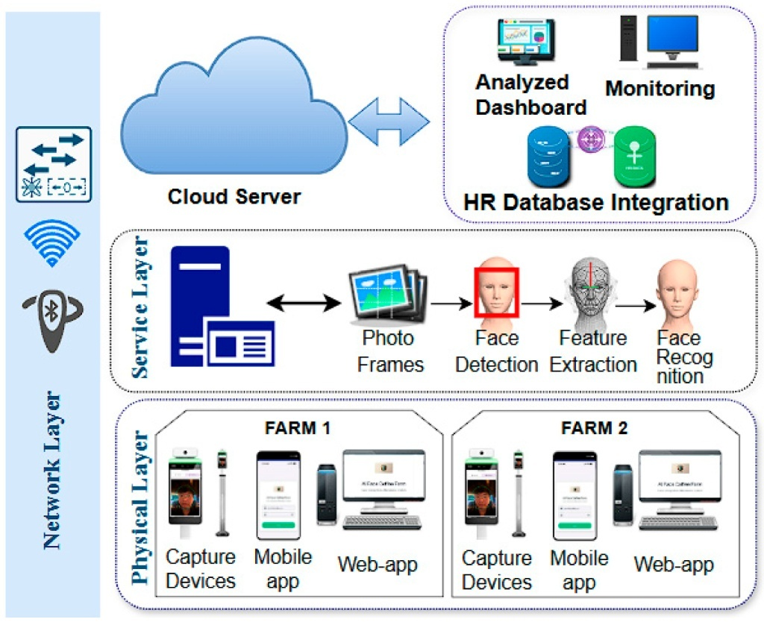
System Architecture Diagram

Slide 9
Future Scope
Liveness Detection: Adding eye-blink or head-movement checks to ensure a real person is in front of the camera (prevents cheating with photos).
GPS Geofencing: Restricting attendance so it can only be marked when the student is physically inside the classroom or campus.
Automatic Timetable: Linking the app to the college schedule so it automatically knows which subject/lecture is currently happening.
Multi-Face Scanning: Upgrading the AI to recognize multiple students at once as they enter the classroom door.
Leave Management: Adding a feature where students can apply for leave directly through the app, and it updates their records automatically.
Cross-Platform Support: Expanding the app to work on iOS (iPhones) and tablets using the same Flutter code.

Slide 10
Conclusion
Efficiency: Our system successfully reduces attendance time from 15 minutes to under 2 minutes per class.
Accuracy & Security: By using AI Face Recognition, we have eliminated "Proxy Attendance" and manual human errors.
Cost-Effective: The project proves that we don't need expensive biometric hardware; a simple Smartphone is enough.
User Empowerment: Both students and teachers now have Real-Time access to attendance data, creating complete transparency.
Digital Transformation: This project is a successful step toward making our college campus Paperless and Tech-driven.

Slide 11
Thank you

